Slide 1
GEHC SDT Weekly Status Report
03/09/17

Slide 2
Open Actions
Action item | Owner | Forum | Expected Closure Date | Actual Closure Date | Owner Comment | Status
Mobility Team or tiger team to be formed to resolve all CLICK mobile issues. | Rohit/Gopi | Jan’ 17 Workout | TBD |  | On the next steps Waiting response from Rohit on FE’s details | In Progress
Performance issues: SDT Booking and Architecture Assessment. | Hita/Andrey/Urmila | Jan’ 17 Workout | 28-Feb-2017 |  | Planning for demo on performance improvements areas we implemented in our local machine. | In Progress
Ownership on Tickets/Process adherence(Agile Mechanism) | Suvarna/Sathyaraj | Jan’ 17 Workout | Ongoing |  |  | In Progress
GEHC to share nonfunctional requirements | Chandra | Jan’ 17 Workout | TBD |  | Few are identified from Rally | In Progress
GEHC to check and confirm on L1 support - on call support | Chandra | Jan’ 17 Workout | TBD |  | CG team confirmed to go for On call support to GE | In Progress
CLICK DB access for CG team GE to setup a separate call to discuss | Chandra | WSR meeting | TBD |  | Click team to provide DB backup on a daily basis and follow-up meeting is scheduled for Monday. | In Progress

Slide 3
Weekly Snapshot – 03/09/17
Health of the Engagement
Highlights
CLICK ASEAN CSC Agent and ASEAN CSC Super User template recreated on Stage and Prod environment
CLICK SR Description and Desired Date field are configured for ASEAN CSC Super User template on Stage and Prod environment
R1.4 Iteration 1 completed and demo with the product owners to get the acceptance.
Testing : System Id blank issue (Pop up for blank System ID) is tested in CRP and working as expected now.
Analysis is in progress on performance testing tool Jmeter which is used to load test functional behavior and measure performance
Testing is in progress for R 1.4 Iteration 1 changes.
Performance testing changes implemented in local and testing is in progress in CRP environment.
GREEN
Risk / Issues / Challenges
Help Needed
Click DB access(Prod, Stage, Sandbox) for Gopi & Preeti
Subsequent cancelling of Backlog grooming of functional user stories sessions may impact Sprint planning activities.
Need resolution to infrastructure related queries and common forum to resolve.
Need support on performance related issues on CLICK side.
Need help from CLICK team on Environment details for further analysis on Mobile sync issue.

Slide 4
Focus Area Updates
Focus Areas | Owner | Status | Comments
Mobile Sync Issues | CG Team | In Progress | Received the artifacts related to debug log configuration file but yet to receive end to end environments details from CLICK team which was requested last week. Had a discussion with our Internal mobile app dev team on click mobile session time, session expired time and retry expired session mechanism. Here are few next steps identified from Tiger and Mobile iron team discussions: Involve functional team. Share test SSO’s with MI, SSO and Click team. Try to capture logs for FEs SSOs on MI and SSO. Analyze the logs for any new ticket raised. Debug mode need to be activated for list of FE’s (waiting response from Rohit on FE’s details)
SDT Booking Performance Issues | CG Team | In Progress | Few already identified performance improvement areas with their dependencies related points in SDT : Inclusion of local database for master data loading in SDT- Communicating with Trace team to check the feasibility. Click calls method Optimization (ClickCallByOperation()) – Minimized geocoding calls which reduced the page load time of SDT SR Data retrieval- Communicating with click team if that is feasible to implement. Indexing mechanism-Analyzing the feasibility from CLICK team Queries are pending regarding architecture assessment with network team.
Release Management | CG Team | Ongoing | Release check list was created and it is updated in our Release readiness check call.
Incident Management | CG Team | Ongoing | Streamlining incidents w.r.t CLICK support cases Problem ticket creation process finalized. Incidents reported in this week are closed.
Support and Development Process streamlining | CG Team | Ongoing | Agile metrics identified and tracked through Rally. Ensuring all email communication to have incident ticket created. Internal defect tracker is maintained to track the QA/UAT defects and owners defined for each defect.

Slide 5

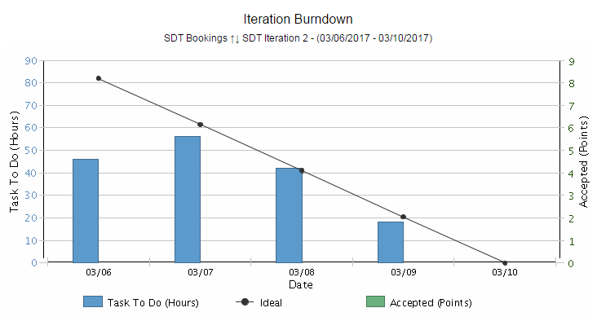
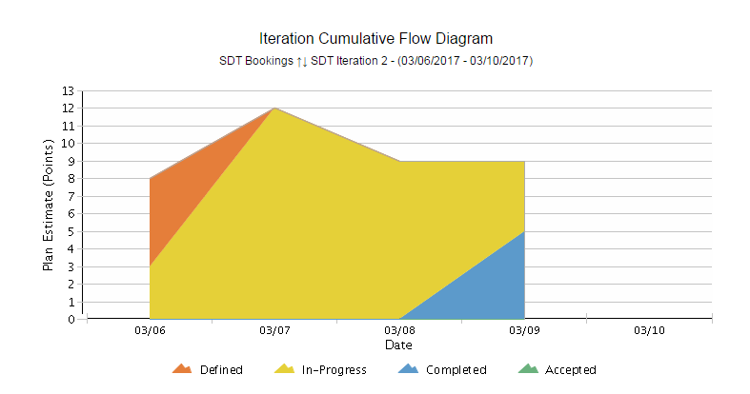
Agile Metrics
SDT Iteration 2 - 6th Mar to 10th Mar ‘17
Iteration Burndown Chart:
This iteration is just 1 week long to help reveal problems/impediments faster and we can get feedback from these user stories from Product owner..
Variations in TO-DO in the middle:
First day ,during sprint planning, added some of the user story in the iteration backlog to get started.
Tasks keep on added up in the middle of the sprint after the approval on technical analysis user story.
To do meets the idea line.
At the end of the sprint we will be able to complete the user stories covered in this iteration.
Iteration Cumulative Flow Diagram
At start of the sprint some of the task are in defined state and started working on some of the tasks from user story which shows In progress state.
Inferences
Inferences

Slide 6
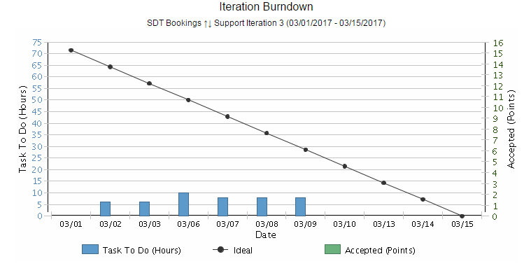
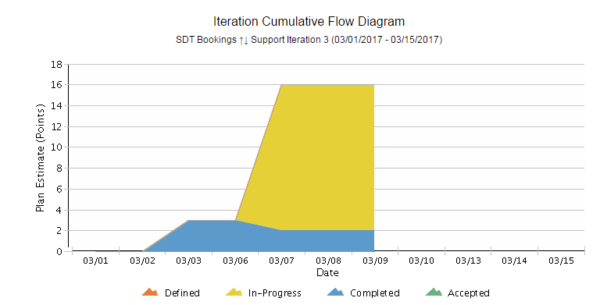
Agile Metrics
SDT Click, Support and Incidents
Support Iteration 3 1st Mar to 15th Mar ‘17
Iteration Support Burndown Chart:
Support activities keep on added up on a daily basis based on the support tickets that we receive. Hence there’s a mismatch with ideal.
End of the sprint, all tickets are closed and most of the user stories are accepted by Product owner.
Iteration Cumulative Flow Diagram
Most of the tickets like Mobile Sync issues,R21. and R2.2 activities are completed.
Some of the incident tickets are in-progress due to Awaiting 3rd party(Click).
Inferences

Slide 7
Incident Update
12 incident tickets are resolved/closed
13 Awaiting 3rd party - Mobile Issues
3 Awaiting User Info
Inferences

Slide 8
Incident Tickets
Incident Management
Incident # | Module | Key Words | Status | Problem #
INC1370193 | SDT Mobile | Mobile sync Issue | Awaiting 3rd Party | NA
INC1435961 | SDT Mobile | Mobile sync Issue | Awaiting 3rd Party | NA
INC1446914 | SDT Mobile | Mobile sync Issue | Awaiting 3rd Party | NA
INC1447037 | SDT Mobile | Mobile sync Issue | Awaiting 3rd Party | NA
INC1447060 | SDT Mobile | Mobile sync Issue | Awaiting 3rd Party | NA
INC1454094 | SDT Mobile | Mobile sync Issue | Awaiting 3rd Party | NA
INC1463913 | SDT Mobile | Mobile sync Issue | Awaiting 3rd Party | NA
INC1464027 | SDT Booking | Click Issue | Awaiting User Info | NA
INC1477114 | SDT Booking | Mobile Sync Issue | Awaiting User Info | NA
INC1480772 | SDT Mobile | Mobile sync Issue | Awaiting User Info | NA
INC1480941 | SDT Mobile | Mobile Validation Issue | Awaiting 3rd Party | NA
INC1735928 | SDT Schedule | Click Issue | Awaiting 3rd Party | NA
INC1736222 | SDT Schedule | Click Issue | Awaiting 3rd Party | NA
INC1738700 | SDT Module | Click Issue | Awaiting 3rd Party | NA
INC1742931 | SDT Module | Click Issue | Awaiting 3rd Party | NA
INC1747182 | SDT Mobile | Click Issue | Awaiting 3rd Party | NA
Problem Management
Problem # | Module | Keyword | Status | Incident #
PRB0045855 | SDT Booking | Google API | Open | INC1371682, INC1389372, INC1357120
PRB0045895 | SDT Booking | Email Activity | Open | INC1285226
PRB0045475 | SDT Booking | Performance - Connectivity | Known Error / Pending CA | INC1310582

Slide 9
THANK YOU

